Slide 1
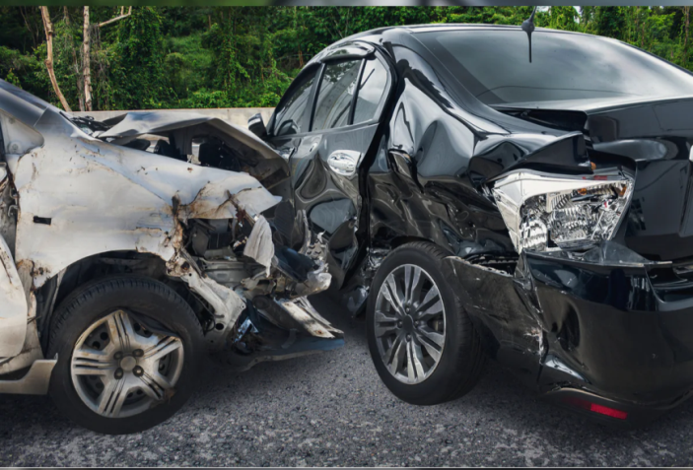
Anti-Accident System
EXCUTIVE SUMMARY:
The number of car accidents on the
roads increased during 2019, and the
number of deaths resulting from car
accidents rose to 3,484 dead in
2019, an increase of 12.9%.
So we thought of making a system of machine learning, which partially calculates the distance and make sure that everything is alright and if it is not then it takes over the task of driving.

Slide 2

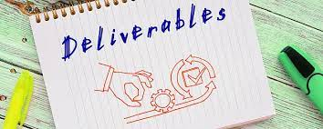
Objectives:
•Reducing accidents.
•Regulating traffic.
•Provide a safe journey for passengers and
drivers.
•Contribute to the eradication of
technology illiteracy.
Deliverables:
•Project plan.
•Anti-accident system.
•The device which will be put in the car.
•Reports.

Slide 3

Recourses of the project will be materials and machine learning system expert.
The most important stakeholders will be ORACLE, El-Garhy Steel and Essam Yousef.
Communication Plan:
An offline meeting every week.
An online meeting every three days.
The budget will be 86 thousand and we have 15 thousand as an emergency budget.

Slide 4
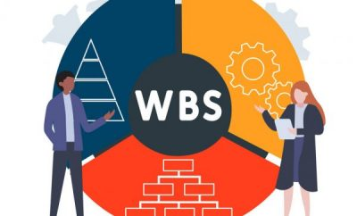
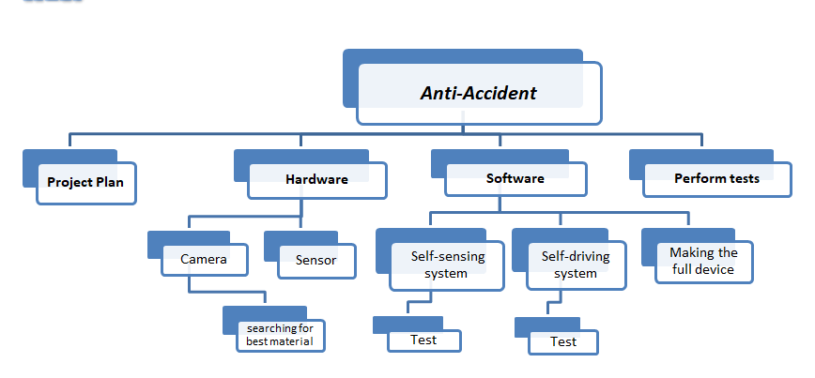
WBS

Slide 5

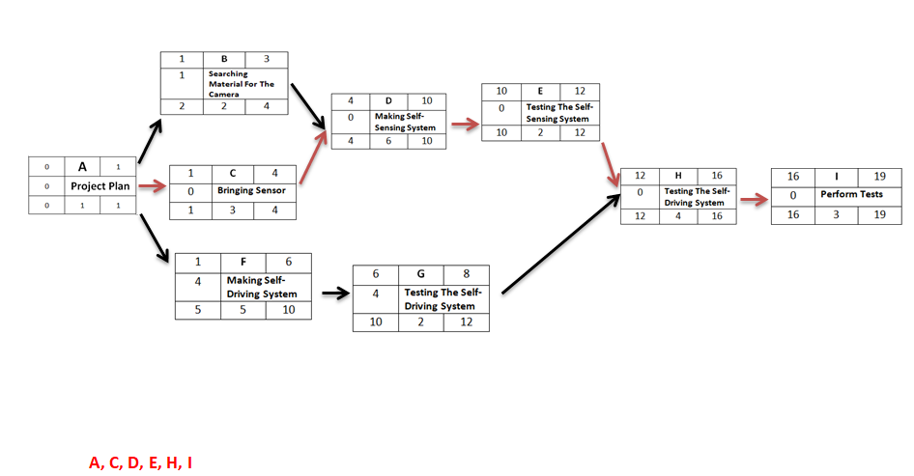
NETWORK

Slide 6
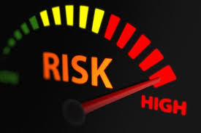
RISKS
We may have some missed requirements if one of the firms decided that it does not want to work with us anymore.
The Solution: we will make sure that there is another company would
help us.
We may lack in the performance of this invention.
The Solution: we will make sure that we hire the perfect team for this
and have external people help us.
The device might not work well and have some problems with it.
The Solution: we will make a check-up every four months.
Not all Egyptian will buy this device
The Solution: we will not let the car license (which happens every
three years) be done unless you have the device installed
in your car.

